Slide 1
Lesson 1
Introduction to Java Web Application Fundamentals
Home of All the Laws of Nature
Notes:
last update: 4/3/2013

Slide 2
Hypertext HTTP HTML
Hypertext is structured text that uses logical links (hyperlinks) between nodes containing text.
  You can go to any place on the Internet whenever you want by clicking on links — there is no set order to do things in.
HTTP[Hyper Text Transfer Protocol] is the protocol to exchange or transfer hypertext.
HTML[Hyper Text Markup Language]] is a Language, as it has code-words and syntax like any other language.
  Markup is what HTML tags do to the text inside them. They mark it as a certain type of text (italicised text, for example).
Notes:
Introduce a document and a wire…Like sending snail mail..once it goes out you don’t have “influence”…
HYPER drive…

Slide 3
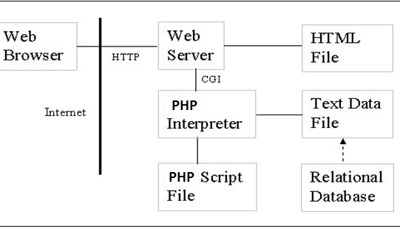
CGI Platform
Common Gateway Interface (CGI) is a standard method used to generate dynamic content on Web pages and Web applications.
Notes:
BASIC web “architecture” --

Slide 4
Servlets – An Efficient Technology
A servlet is server-side java code that can handle http requests and return dynamic content
Servlets are managed by a servlet engine or container.
Each request that comes in results in the spawning of a new thread that runs a servlet
(eliminating the cost of creating a new process every time).
Notes:
Talk about SUN/JAVA networking/engineering …
Goal was performance

Slide 5
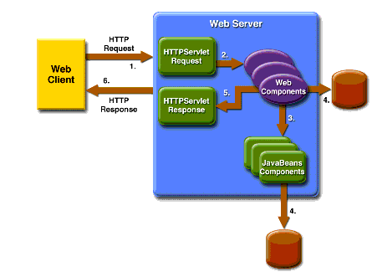
Java Web Applications
In the Java 2 platform, web components provide dynamic extension capabilities for a web server. Servlets, JSPs and JSFs are web components.
Client sends an HTTP request to the web server.
Web server [via Servlet container] converts the request into an HTTPServletRequest object which is delivered to the Servlet
Servlet interacts with JavaBeans components
or a database to generate dynamic content
Servlet generates an HTTPServletResponse object
Web server [via Servlet container] converts this object to an HTTP response and returns it to the client
Notes:
http://docs.oracle.com J2EE Tutorial Getting Started with Web Applications

Slide 6
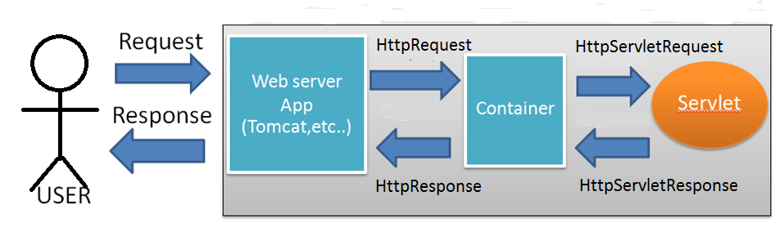
Servlet Container
When a request comes to the web server, based on the URL, the server passes the request data to the servlet container.
Servers that support servlets have as a helper app: servlet container.
The servlet container locates the servlet, creates SERVLET request and response objects and passes them to the servlet, and returns to the web server the response stream that the servlet produces.

Slide 7
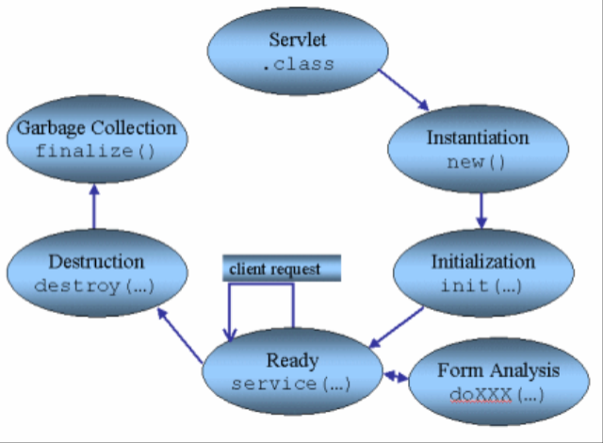
Servlet Lifecycle
HelloWorldServlet- compiled & deployed when “Run As” is invoked
Application termination or Servlet Container shutdown calls destroy() method
Loaded [through new()] & init’ed when FIRST request is received [ or configured to load on startup]
A request is forwarded to the Servlet’s service() method.
HttpServlet service() method calls doGet,doPost,etc.

Slide 8
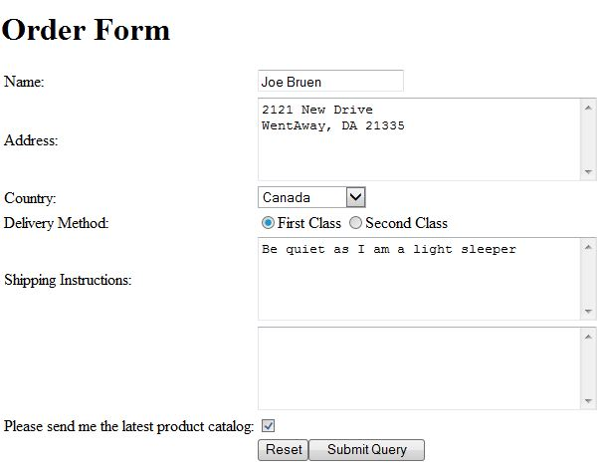
A Simple Order Form

Slide 9
Servlet Code doGet Example
protected void doGet(HttpServletRequest request, ...
response.setContentType("text/html");
PrintWriter writer = response.getWriter();
writer.println("<html>");
writer.println("<head>");
writer.println("<title>" + TITLE + "</title></head>");
writer.println("<body><h1>" + TITLE + "</h1>");
writer.println("<form method='post'>");
writer.println("<table>");
writer.println("<tr>");
writer.println("<td>Name:</td>");
writer.println("<td><input name='name'/></td>");
writer.println("</tr>");
writer.println("<tr>");
writer.println("<td>Address:</td>");
writer.println("<td><textarea name='address' "
+ "cols='40' rows='5'></textarea></td>");
writer.println("</tr>");

Slide 10
Continued
writer.println("<tr>");
writer.println("<td>Country:</td>");
writer.println("<td><select name='country'>");
writer.println("<option>United States</option>");
writer.println("<option>Canada</option>");
writer.println("</select></td>");
writer.println("</tr>");
writer.println("<tr>");
writer.println("<td>Delivery Method:</td>");
writer.println("<td><input type='radio' "
+ "name='deliveryMethod'"
+ " value='First Class'/>First Class");
writer.println("<input type='radio' "
+ "name='deliveryMethod' "
+ "value='Second Class'/>Second Class</td>");
writer.println("</tr>");
writer.println("<tr>");
writer.println("<td>Shipping Instructions:</td>");
writer.println("<td><textarea name='instruction' "
+ "cols='40' rows='5'></textarea></td>");
writer.println("</tr>");

Slide 11
And More
writer.println("<tr>");
writer.println("<td>&nbsp;</td>");
writer.println("<td><textarea name='instruction' "
+ "cols='40' rows='5'></textarea></td>");
writer.println("</tr>");
writer.println("<tr>");
writer.println("<td>Please send me the latest " +
"product catalog:</td>");
writer.println("<td><input type='checkbox' " +
"name='catalogRequest'/></td>");
writer.println("</tr>");
writer.println("<tr>");
writer.println("<td>&nbsp;</td>");
writer.println("<td><input type='reset'/>" +
"<input type='submit'/></td>");
writer.println("</tr>");
writer.println("</table>");
writer.println("</form>");
writer.println("</body>");
writer.println("</html>");

Slide 12
Web Application Deployment Descriptor (web.xml)
Defines everything about your Java Web Application that a server needs to know:
Servlets
Initialization parameters
Listeners
Filters
Error pages
Welcome pages

Slide 13
Three Names of a Servlet
[web.xml]
<servlet>
<servlet-name>hello</servlet-name>
<servlet-class>mum.Hello</servlet-class>
</servlet>
<servlet-mapping>
<servlet-name>hello</servlet-name>
<url-pattern>/hello</url-pattern>
</servlet-mapping>
“servlet-name” is the internal name of the servlet
“servlet-class” is the Java name of the class
“url-pattern” is the way the servlet is specified in the
browser http:localhost:8080/HelloWorld/hello and the
HTML form <form action="hello" method="get">
This is a “VIRTUAL” name

Slide 14
“special” URL Patterns
Default Servlet Mapping:
<url-pattern>/</url-pattern> matches a request if no other pattern matches.
<url-pattern>/*</url-pattern> overrides all other servlets. Whatever request you fire, it will end up in that servlet.
Notes:
Every character in a pattern must match the corresponding character in the URL path EXACTLY
Two exceptions:
At the end of a pattern, /* matches any sequence of characters from that point forward.
The pattern *.extension matches any “file name” ending with extension.

Slide 15
ServletConfig & ServletContext
ServletConfig is a configuration object PER servlet to pass initialization information to a servlet during servlet init().
ServletContext holds parameters that are initialization information for the entire application(i.e, every servlet in the application). ServletContext is also used during the application for application state management.
<web-app>
<servlet>
<servlet-name>order</servlet-name>
<servletclass>mum.edu.cs.Order</servlet-class>
<init-param>
<param-name>servletName</param-name>
<param-value>MVC2</param-value>
</init-param>
</servlet>
<context-param>
<param-name>applicationName</param-name>
<param-value>Order Form</param-value>
</context-param>
<listener>
<listener-class>mum.edu.listener.OrderContextListener </listener-class>
</listener>
</web-app>

Slide 16
OrderFormStartup Demo
Override Servlet init() – to process the Servlet init-param FROM web.xml:
<init-param>
<param-name>servletName</param-name>
<param-value>MVC2</param-value>
</init-param>
    public class Order extends HttpServlet {
    // Store servlet init-param here
    String servletName;
    @Override
    public void init( ) throws ServletException {
    servletName =
    getServletConfig().getInitParameter("servletName");
    }
1
2

Slide 17
OrderFormStartup Demo [Cont.]
Implement Listener to process Application Context context-param [web.xml]:
<context-param>
<param-name>applicationName</param-name>
<param-value>Order Form</param-value>
</context-param>
<listener>
<listener-class>mum.edu.listener.OrderContextListener </listener-class>
</listener>
    public class OrderContextListener implements ServletContextListener{
    public void contextInitialized(ServletContextEvent event){
    ServletContext servletContext = event.getServletContext();
    String applicationName =
    servletContext.getInitParameter("applicationName");
    servletContext.setAttribute("applicationName", applicationName);
    }
1
2
3

Slide 18
Main Point
Servlets are the basis of dynamic Java web applications. Servlets process information from a request object and generate new information in a response object.
This request/response functionality is an example of the concept that For every action in nature there is always a reaction.

Slide 19
Java Server Pages
Architecturally, a Java Server Page is a high-level abstraction of Java servlets.
It is a type of Java servlet that is designed to fulfill the role of a user interface for a Java web application.
Developers write JSPs as text files that combine HTML or XHTML code, XML elements, and embedded JSP actions and commands.

Slide 20
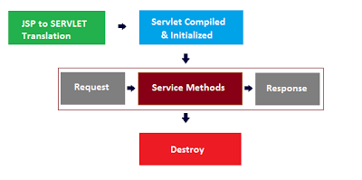
JSP Lifecycle

Slide 21
A Simple Order Form “DEMO”

Slide 22
public void _jspService(final javax.servlet.http.HttpServletRequest request, final javax.servlet.http.HttpServletResponse response)
try {
response.setContentType("text/html");
pageContext = _jspxFactory.getPageContext(this, request, response, null, true, 8192, true);
_jspx_page_context = pageContext;
application = pageContext.getServletContext();
config = pageContext.getServletConfig();
session = pageContext.getSession();
out = pageContext.getOut();
_jspx_out = out;
out.write("<!DOCTYPE html>\r\n");
out.write("<html>\r\n");
out.write("<head>\r\n");
out.write("<link rel=\"stylesheet\" type=\"text/css\" href=\"resources/mystyle.css\">\r\n");
out.write("<meta charset=\"ISO-8859-1\">\r\n");
out.write("<h4>Order</h4>\r\n");
out.write("</head>\r\n");
out.write("<body>\r\n");
out.write("\t<form method=\"post\">\r\n");
out.write("\t\t <table> \r\n");
out.write(" \t<tr> \r\n");
out.write(" \t\t<td>Name:</td> \r\n");
out.write(" \t\t<td><input name='name'/></td>\r\n");
out.write(" \t</tr> \t\r\n");
out.write("\t\t\t<tr>\r\n");
out.write(" \t\t<td>Address:</td> \r\n");
out.write(" \t\t<td><textarea name='address' cols='40' rows='5'></textarea></td> \r\n");
out.write(" \t</tr> \t\r\n");
Notes:
How are JSP pages related to servlets?
Give an example of a JSP expression and show how it will look in the JSP servlet.

Slide 23
Scriptlets
SCRIPLETS [UGH!]
BETTER THAN SERVLETS!!!
See JspIntroDemo/PostMessage.jsp
Notes:
See JspIntroDemo in STS PostMessage.jsp for Scriptlets
Also ProductVariationDetail.jsp

Slide 24

“Scripting considered harmful”
JSP scripting originated in early days of web apps
JSPs try to avoid scripting
Might see in legacy code
Might see something similar in other frameworks
  PHP
  ASP.net
  ASPMVC.net
  …?
Scripting is part of “Model 1 JSP architecture”
Notes:
Why are “scriptlets considered harmful”.

Slide 25
Scriptless JSPs
The JSP Expression Language (EL)
  Syntax: ${person.name}
  Left value is either an attribute or an implicit object (like request), right side is a property
Tag Libraries
There is a standard set of additional tags for JSP pages that encapsulate functionality of scriptlets (like for loops), thereby eliminating embedded code

Slide 26
JSP Expression Language [EL]
An expression ${expr} prints expr to the page
An expression ${person.name} evaluates (and prints to the page) something like: person.getName(), where person is an instance of a Person bean having a name variable.
Has arithmetic and logical operators
To test whether two objects are equal, EL uses eq[or ==] for equals and ne[or !=] for not equals
Can use integers, floating point numbers, strings, the built-in constants true and false for boolean values, and null.

Slide 27
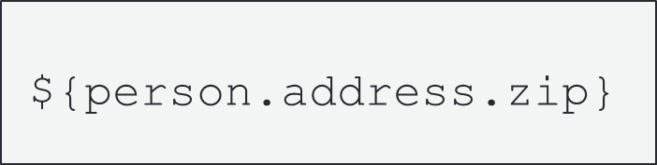
Expression Language versus
Scriptlet
Example: We have a person object stored as a request attribute. A person has an address and an address has a zip. How to retrieve zip?
Scripting approach:
EL approach:
<%((edu.mum.Person)request.getAttribute(“person”)).
getAddress().getZip() %>

Slide 28
JSTL – JSP Standard Tag Library
Provides new tags for JSPs that reduce scripting
They use the custom tag API, but have become a standard library, essentially a part of JSP language

Slide 29
Using JSTL
The JSTL library provides 5 Sets of tags, each having a different (standard) prefix. You “import” a library by placing a “taglib” directive at the top of your jsp page. Here are the choices:
Core tags: (can do if, if/else, loops…)
<%@ taglib prefix="c"
uri="http://java.sun.com/jsp/jstl/core" %>
NOTE: the taglib directive has no XML syntax analog

Slide 30
Additional Tags
Function tags: (standard Java string manipulation)
<%@ taglib prefix="fn« uri="http://java.sun.com/jsp/jstl/functions" %>
Format Tags (format numbers, dates..)
<%@ taglib prefix="fmt" uri="http://java.sun.com/jsp/jstl/format" %>
SQL Tags (set data source, perform queries)
<%@ taglib prefix="sql" uri="http://java.sun.com/jsp/jstl/sql" %>
XML Tags (for navigating/parsing/working with XML files)
<%@ taglib prefix="x" uri="http://java.sun.com/jsp/jstl/xml" %>
Head First, p. 475 lists all the available JSTL library tags

Slide 31
C:OUT
Preventing XSS (Cross Site Scripting)
Encode “untrusted data”
Replace HTML markup with alternate representations
For example, <script> gets converted to &lt;script&gt;.
Sample Character representations:
Char Description Entity name Entity number
Space &nbsp; &#160;
< Less than &lt; &#60;
> Greater than &gt; &#62;
& Ampersand &amp; &#38;
Open Web Application Security Project (OWASP)

Slide 32
C:URL provides for URL Encoding
URLs can only be sent over the Internet using the ASCII character-set.
Since URLs often contain characters outside the ASCII set [UTF-8/Unicode], the URL has to be converted into a valid ASCII format.
URL encoding replaces “unsafe” ASCII characters with a "%" followed by two hexadecimal digits.
For example, URLs cannot contain spaces. URL encoding normally replaces a space with a plus (+) sign or with %20.
Percent Encoding
Unsafe Characters: rfc1738
Notes:
“unsafe” --- recommendation for trouble-free interchange
UTF8-UNICODE is outside the ASCII set….
http://www.w3schools.com/tags/ref_urlencode.asp
https://support.tigertech.net/non-ascii-urls
https://perishablepress.com/stop-using-unsafe-characters-in-urls/
https://en.wikipedia.org/wiki/UTF-8

Slide 33
JSTL DEMO
DEMO: show how to use some of them…
c:set (set value of a variable)
c:out --- XSS character escaping
c:if
c:choose
c:forEach
c:url --- with URL encoding
Many of these make simple use of the EL.

Slide 34
MVC: Model-View-Controller
Separation of Concerns
Separates the modeling of the domain, the presentation, and the actions based on user input into three separate classes
Model
Maintains the data[i.e. state] of the application domain
View
Manages the display of information.
Controller
Manages user input triggering the model and/or the view to change as appropriate.
Notes:
https://stackoverflow.com/questions/1866821/is-mvc-a-design-pattern-or-architectural-pattern
MVC was invented at Xerox Parc in the 70's..Smalltalk-80…desktop
Original SMALLTALK
Xerox Palo Alto Research Center (PARC)

Slide 35
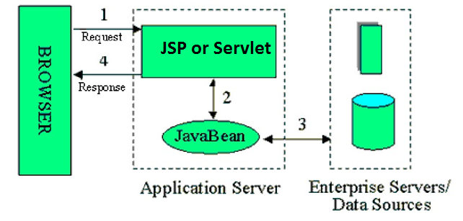
Model 1 Architecture
Model 1 mixes view and business logic inside each handling servlet (or JSP). This makes it more difficult to change the view independently of that logic, and difficult to change business logic without changing the view.
Notes:
JavaWorld - Server-side Java By Govind Seshadri
Understanding JavaServer Pages Model 2 architecture

Slide 36
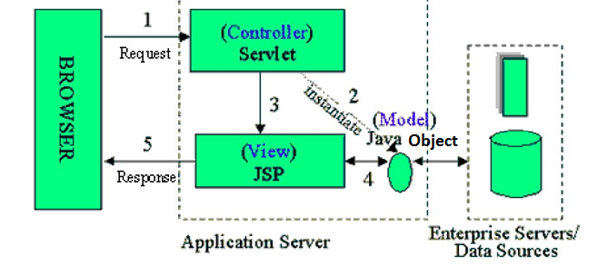
JSP Model 2 Architecture
Model II cleanly separates business data and logic from the view, and the two are connected by way of a controller servlet. The model allows for multiple controllers/servlets, [e.g., one per GET/POST pair]. Typical MVC Framework implementations have just one controller servlet which centralizes common tasks.
Notes:
update of view from model as “optional” – could be through controller
JavaWorld - Server-side Java By Govind Seshadri
Understanding JavaServer Pages Model 2 architecture
https://developer.mozilla.org/en-US/Apps/Fundamentals/Modern_web_app_architecture/MVC_architecture

Slide 37
DEMO
JSP Intro Demo :
MVC1 – MVC2 examples
Notes:
JSPIntroDemo

Slide 38
Main Point
When you use JSP pages according to a Model 2 MVC architecture, It enforces a separation of concerns. There is a servlet that acts as a controller that sets attribute values based on computations and results from the domain model, then dispatches the request to the JSP view page. This is similar to the concept of knower [domain model], knowing [controller ] & known[view].
.
Notes:
What is the main value of JSP?
How are JSP pages related to HTML?

